Slide 1
ECHO-VERSE AUDIOBOOK
TEAM NAME:HachOps
Team members:
A.Geethanjali
B.Lahari
A.Vaibhav

Slide 2
INTRODUCTION
The project EchoVerse Audiobook is a browser-based application that transforms written narration into spoken audio while also adapting the tone of the text. Users can paste their text, select a desired tone (Neutral, Suspensefu, or Inspiring), and listen to the adapted narration through speech synthesis. The application demonstrates both the original and rewritten versions side by side, making it useful for audiobook creation, storytelling, or adaptive narration. In demo mode, it works offline using the browser’s built-in voices, and when connected to a backend, it integrates with IBM watsonx LLM for tone rewriting and IBM Watson Text-to-Speech (TTS) for high-quality downloadable audio.

Slide 3
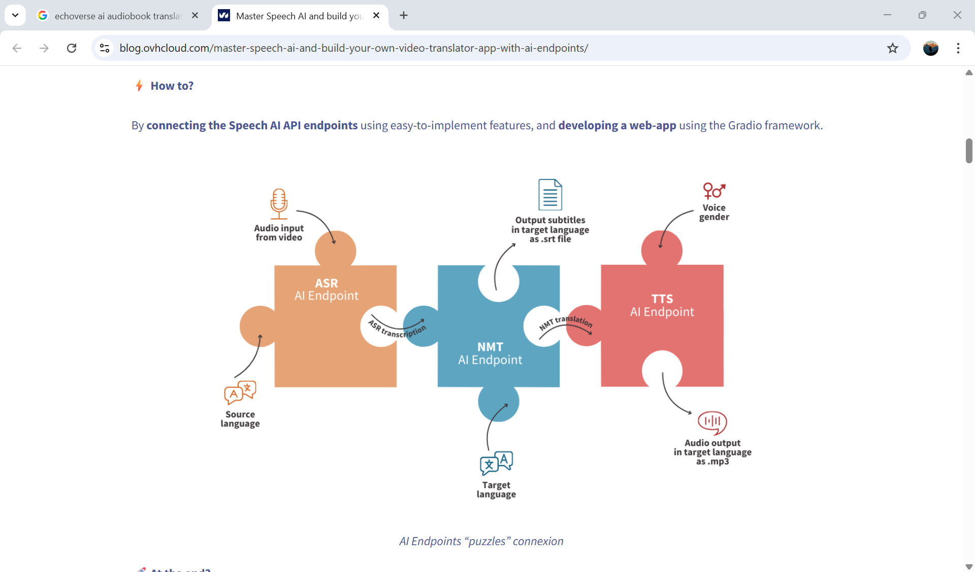
ARCHITECTURE

Slide 4
FUTURE SCOPE
There is considerable potential to expand this prototype into a more advanced audiobook platform:
Advanced Tone Adaptation: Using fine-tuned LLMs to generate context-aware rewrites with more nuanced tones (e.g., dramatic, humorous, motivational).
Multi-Language Support: Enabling narration in multiple global languages with localized tones and expressions.
Subtitle Generation: Exporting synchronized .srt or .vtt files for captions, helpful for accessibility and video integration.

Slide 5
Word-level Highlighting: Highlighting text as it is spoken, enhancing usability for learners and audiobook listeners.
Cloud Storage & Collaboration: Allowing users to save, share, and collaboratively edit audiobook drafts.
Mobile & Desktop Apps: Wrapping the web app into a cross-platform application for wider accessibility.

Slide 6
SOLUTION
The solution provided by EchoVerse bridges the gap between static text and engaging narration. In the demo setup, it offers immediate offline functionality through browser voices, making it simple and portable. For professional use, it connects to IBM’s AI ecosystem: the watsonx LLM ensures that the narration tone matches user preferences, while Watson TTS generates natural-sounding audio suitable for publishing. This two-step pipeline—tone rewriting → text-to-speech conversion—creates a versatile solution for audiobook creation, podcast scripting, or adaptive e-learning content.

Slide 7
ADVANTAGES:
1.Provides a complete web-based audiobook generator.
2. Works both offline with browser voices and online with IBM Watson TTS.
3. Offers tone-adaptive rewriting (Neutral, Suspenseful, Inspiring) for engaging narration.
4. Dual-pane layout allows side-by-side comparison of original vs. rewritten text.
DISADVANTAGES:
1. The rewriting in demo mode is basic, relying only on simple templates
2. LLM-powered rewriting requires backend integration, not included by default.
3. In demo mode, MP3 download is not available, only live playback.
4. Voice quality varies depending on the browser and operating system.

Slide 8
CONCLUSION
EchoVerse Audiobook demonstrates how AI can enhance traditional narration by making text more expressive and adaptive. The architecture ensures flexibility, offering offline demos and scalable production integration with IBM Cloud services. With future enhancements like multilingual support, subtitle export, and word-level interactivity, the project can evolve into a powerful platform for content creators, educators, and storytellers. In essence, it highlights the potential of combining language models with speech synthesis to create immersive and personalized audiobook experiences.

Slide 9
THANK YOU

